Slide 1
Tarrytown Housing Committee
Sadie McKeown (Chair); Gary Friedland; Peter Feroe; Rose Noonan; Alexander Roberts; Craig Singer
Mayor Brown & Deputy Mayor McGovern; Trustee Liaisons
Richard Slingerland; Staff Support
May 2, 2022

Slide 2
Housing Affordability Task Force: Mission Statement
To provide the Village of Tarrytown with an understanding of existing housing supply, identify housing needs and trends to support current and future populations of the village, define opportunities within the existing stock, in future developments and with the tools available through land use planning, zoning and vision to incentivize and preserve integrated and affordable, workforce and middle-income housing for the long-term benefit of the community

Slide 3
Housing Committee Activity
Part of Comprehensive Plan Management Committee structure
Advise Village and non-profits :
Village of Tarrytown Affordable Housing Fund
Re-housing YMCA residents
Tarrytown Rental Assistance Program – emergency assistance during pandemic
Ongoing and Future Tasks
Advise Village and non-profit with respect to Franklin Terrace rehabilitation
Recommend zoning changes and other tools to promote the retention and creation of affordable housing options; both regulated and non-regulated
Advise Village on new development projects; ensure they further our Village’s Housing goals

Slide 4
Housing Supply
Our region doesn’t produce enough new housing
Suburban NY counties granted fewer building permits per capita than any other suburban county in MA, CT, NJ, PA, MD, nVA, save Delaware County, PA (2000-2018)
Westchester, Nassau, Suffolk share of regional population declined from 24.5% (1980) to 19.2% (2018)
Housing scarcity is driving up prices, creating economic distortions, and impacting current and future residents

Slide 5
Municipal Strategies to Make Housing More Affordable
Direct Construction / Facilitation
Municipal housing, special funds, making land available
Inclusionary Zoning
Set-asides during new construction
Reduce Regulatory Costs
Improve speed and certainty of approvals, targeted reduction of fees and taxes
Permit Expanded Supply
Calibrate types of housing
Balance with potential impacts and impacts
Create co-benefits for existing community and property owners

Slide 6
Accessory Dwelling Units (ADUs)
2nd dwelling unit on the property of an existing home
Attached: Attic, basement, addition
Detached: Detached garage, new cottage
Smaller size; smaller households (singles, younger, and older)
Support existing neighborhoods (existing residents; existing character)
Also known as granny flats, in-law units; but not restricted to families

Slide 7
From the Comprehensive Plan
“In areas with large lots and single-family homes, permitting the division into two- or three-family homes, introducing in-law apartments, or allowing accessory units are strategies that could enable more efficient use of existing resources. Although accessory units may increase the Village’s regulatory burden, where appropriate, they represent an additional source of monthly income for a homeowner as well as a potentially affordable rental arrangement.”

Slide 8
Timeline
Presentation to BoT in 2021
BoT authorized committee to develop ADU proposal for consideration
Requested more information on ADUs
2021/2022: develop consensus on key provisions of potential ADU ordinance
Part of 2021/2022 spent monitoring/ responding to state ADU proposal
Tonight
Information
Highlights of Proposal

Slide 9
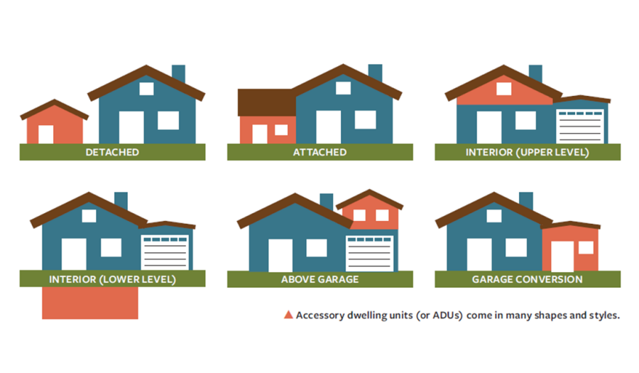
Accessory Dwelling Units

Slide 10
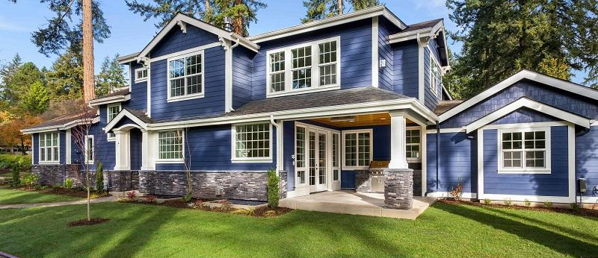
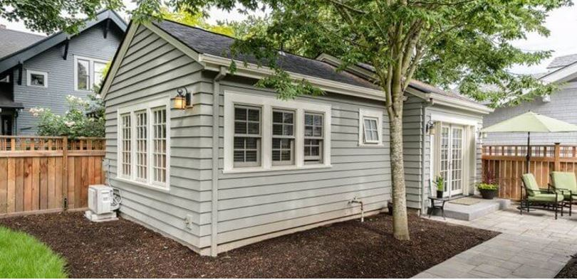
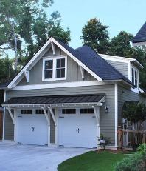
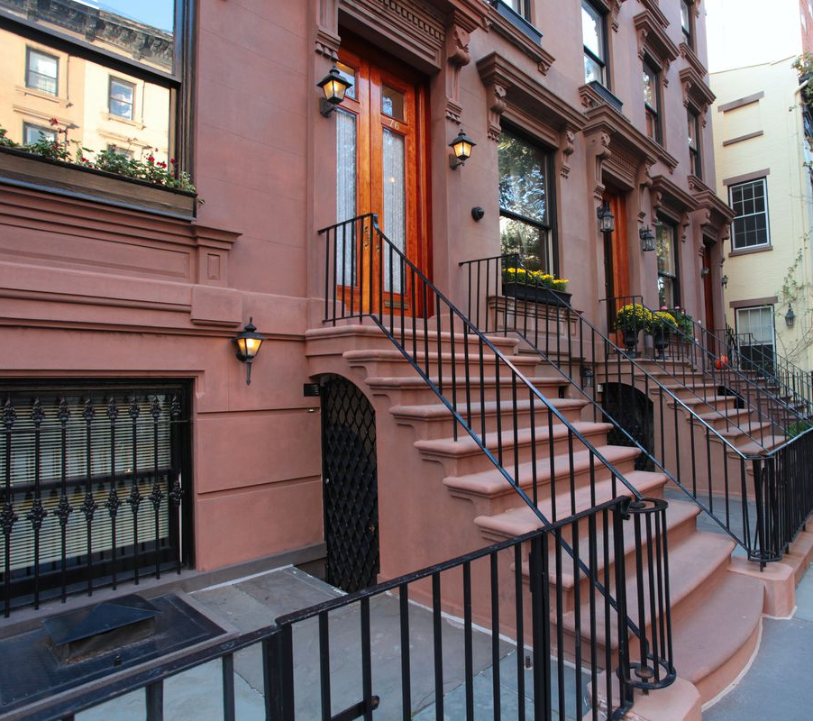
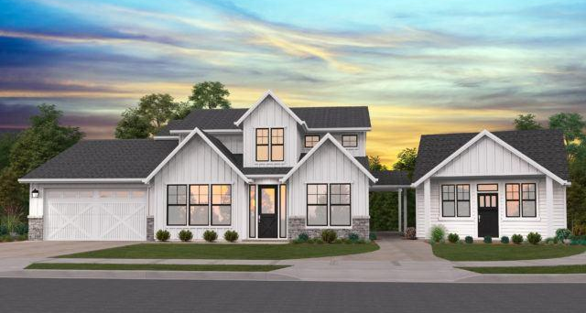
ADU Examples
Attached ADU on house
Backyard ADU SOURCE City of Santa Ana
Above garage
Basement ADU-Image Source-Curbed NY and Shutterstock
Detached-breezway

Slide 11
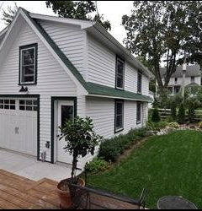
Potential Benefits of ADUs
Allows for the creation/legalization of “little a” affordable units
Provide income for existing residents
Minimal changes to existing neighborhoods
No additional land costs
Low cost of construction
Minimal impacts to infrastructure
Accessory dwelling unit garage

Slide 12
Zoning / Regulatory Questions
Where in Village (which zoning districts)
Owner-occupant on premises
Setbacks, height, area requirements
Parking Required?
Application & renewal processes
Size of units (sf, bedrooms)

Slide 13
Zoning / Regulatory Questions
Where in Village (which zoning districts)
Owner-occupant on premises
1 per lot in Single-Family Zones
Setbacks, height, area requirements
Parking Required?
Application & renewal processes
Size of units (sf, bedrooms)

Slide 14
Zoning / Regulatory Questions
Where in Village (which zoning districts)
Owner-occupant on premises
1 per lot in Single-Family Zones
Setbacks, height, area requirements
Parking Required?
New construction must conform to zoning
Existing non-conforming can participate
Lot size limit on new detached ADUs
Application & renewal processes
Size of units (sf, bedrooms)

Slide 15
Zoning / Regulatory Questions
Where in Village (which zoning districts)
Owner-occupant on premises
1 per lot in Single-Family Zones
Setbacks, height, area requirements
Parking Required?
New construction must conform to zoning
Existing non-conforming can participate
Lot size limit on new detached ADUs
Application & renewal processes
Size of units (sf, bedrooms)
2 BR’s
Detached: < 1,000 sf & (< ½ of main unit)
Attached: Varies by construction type

Slide 16
Zoning / Regulatory Questions
Where in Village (which zoning districts)
Owner-occupant on premises
1 per lot in Single-Family Zones
Yes (either unit)
Setbacks, height, area requirements
Parking Required?
New construction must conform to zoning
Existing non-conforming can participate
Lot size limit on new detached ADUs
Application & renewal processes
Size of units (sf, bedrooms)
2 BR’s
Detached: < 1,000 sf & (< ½ of main unit)
Attached: Varies by construction type

Slide 17
Zoning / Regulatory Questions
Where in Village (which zoning districts)
Owner-occupant on premises
1 per lot in Single-Family Zones
Yes (either unit)
Setbacks, height, area requirements
Parking Required?
New construction must conform to zoning
Existing non-conforming can participate
Lot size limit on new detached ADUs
No
Application & renewal processes
Size of units (sf, bedrooms)
2 BR’s
Detached: < 1,000 sf & (< ½ of main unit)
Attached: Varies by construction type

Slide 18
Zoning / Regulatory Questions
Where in Village (which zoning districts)
Owner-occupant on premises
1 per lot in Single-Family Zones
Yes (either unit)
Setbacks, height, area requirements
Parking Required?
New construction must conform to zoning
Existing non-conforming can participate
Lot size limit on new detached ADUs
No
Application & renewal processes
Size of units (sf, bedrooms)
2 BR’s
Detached: < 1,000 sf & (< ½ of main unit)
Attached: Varies by construction type
Building Dept application
Renewal not required
180 day for existing ADUs

Slide 19
Next Steps
Develop proposed Local Law for BoT
BoT review, revise, amend proposed Law
Public Hearing
Develop outline for supporting programs
Financing, capacity building

